Slide 1


Report on HITSP/TN905 – Safe? Effective? Say what?!
Silver Spring, Maryland | January 26, 2010
Presented by:
Todd Cooper
Lead Editor, HITSP/TN905
enabling healthcare interoperability

Slide 2
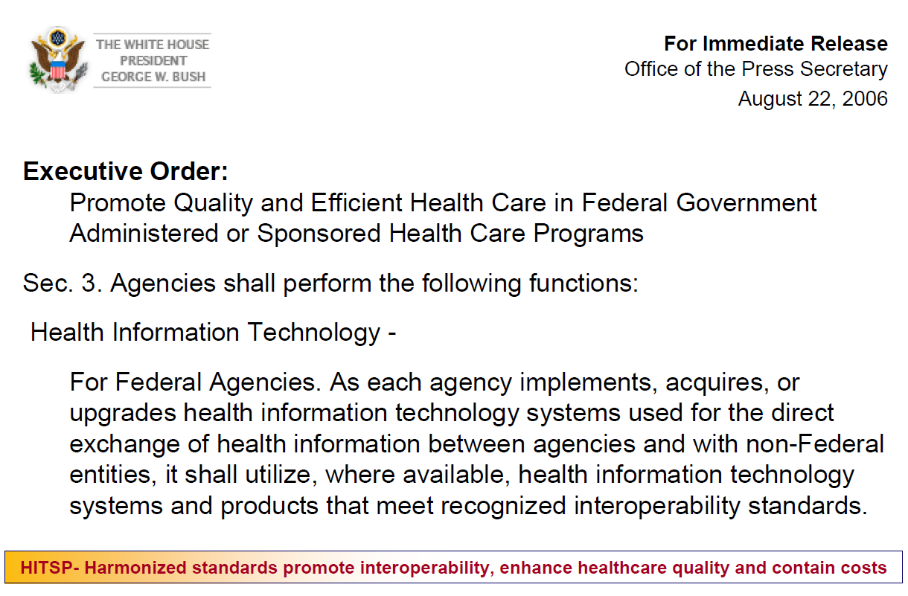

Slide 3
HHS Secretary
Kathleen Sebelius
Team
HHS ONC National HIT Coordinator, David Blumenthal, MD
John Halamka, MD HITSP Chair
Panel, Committees, and Tiger Teams
HHS ONCHIT1
PO, Carol Bean, PhD
Project Management Team
Executive in Charge, F. Schrotter, ANSI
Program Manager, L. Jones GSI
Deputy PM, J. Corley, ATI
Project Manager, A. Peterson,
Booz Allen
Process Definition Technical Manager
Michelle Deane, ANSI
Standards Implementation Technical Manager
Joyce Sensmeier, RN, HIMSS

Slide 4
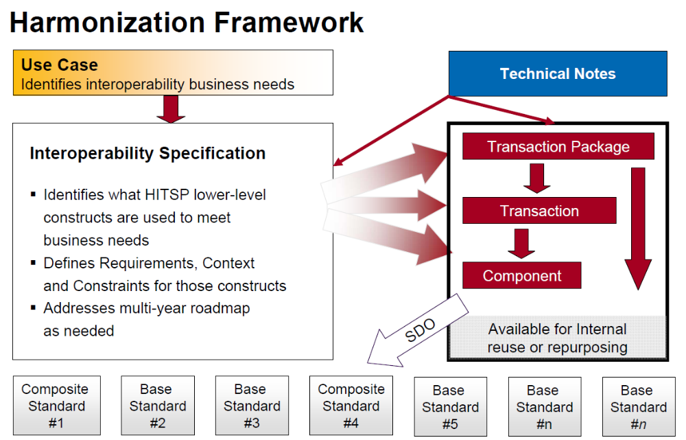

Slide 5
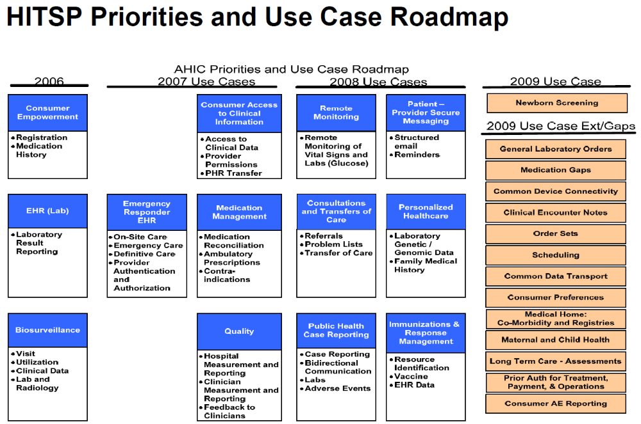

Slide 6
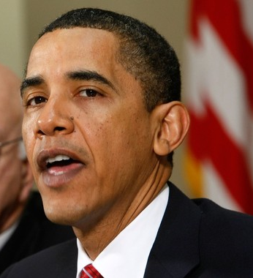
2009 – Obama vows to continue the HIT Plan begun by President Bush
President Barack Obama announces an audacious plan: Computerize all health records within five years.
- January 12, 2009
February 17, 2009 – the American Reinvestment and Recovery Act (ARRA) is signed into law
  HITECH Act component of ARRA provides a $19 billion program to stimulate the adoption and use of HIT, with a focus on meaningful use of certified EHR-S

Slide 7

What about device connectivity?

Slide 8
Why a Technical Note?
Lack of medical device literacy in general HIT community
Multiple sources of HITSP device connectivity requirements – some overlapping, some missing
Lack of understanding about regulatory … opportunities!
Safety? Effectiveness? Huh?!

Slide 9

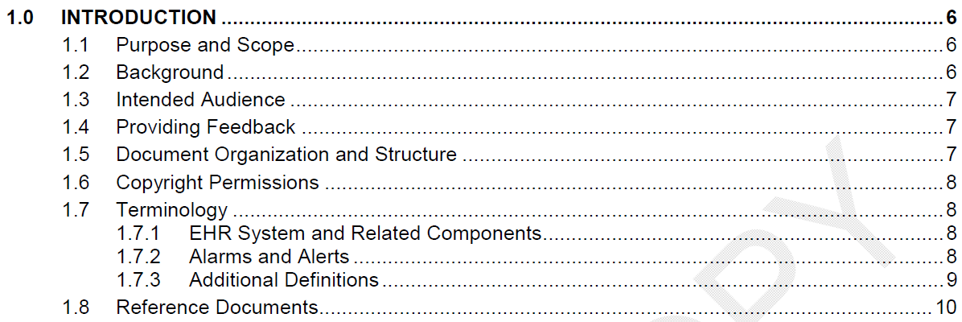
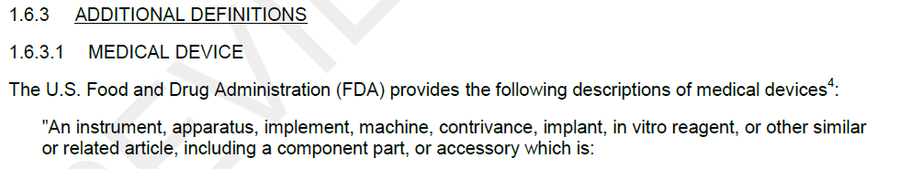

Slide 10
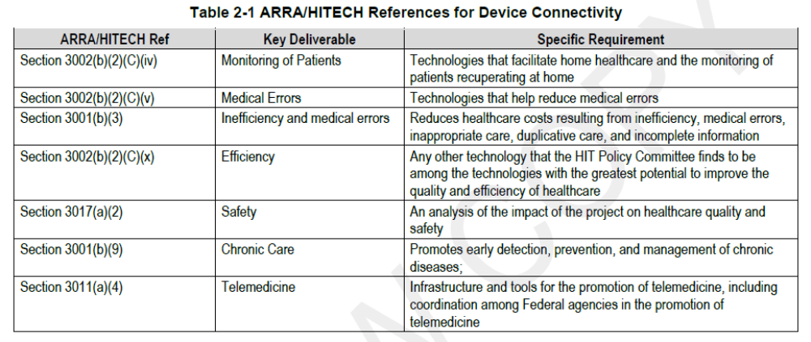

Slide 11
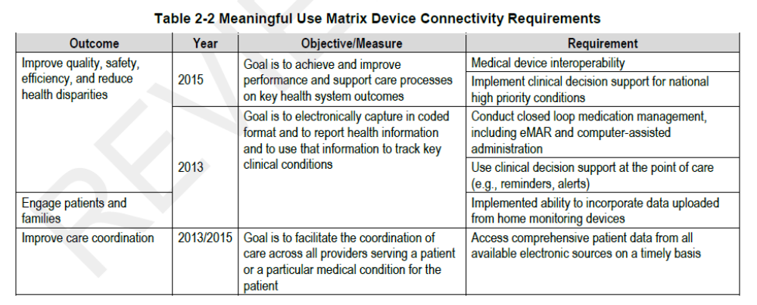

Slide 12
General Considerations
Application Integration
Clinical Pathways and Workflow
Highly-Integrated Patient-Centric Point-of-Care & “ICE”

Slide 13
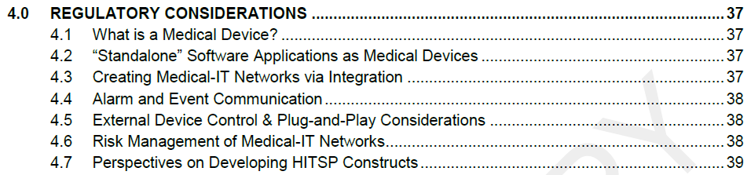
Content provides a “heads up” only!

Slide 14
Charting a path forward…
Consolidated list of connectivity requirements
Roadmap section charts a course for meeting device connectivity requirements
“Gaps” table identifies foundational deliverables + time frame + organizations
Not included: Addressing regulatory issues!

Slide 15
Regulatory issues NOT considered in the roadmap…
Education … especially HIT community
CE-IT Convergence + 80001 …
Regulatory model for safe & effective enterprise heterogeneity
Ensure ONC/HITSP Capabilities & Constructs support safe & effective interoperability

Slide 16
Thanks to key contributors…
  John Donnelly (HITSP Facilitator)
  Ken Fuchs
  Tracy Rausch
  John Rhoads
  John Zaleski
Approved document (v 0.1) after 2010.01.31 @
  www.HITSP.org => View All Documents

Slide 17
Questions?

